Slide 1

ACBSD-4272 Solution Design - Final: Document Scanning – Assessment Automation RITM1149048 - OneTrust
Mohamed Kerbachi
03/ 05 / 2026
Internal

Slide 2
Version Control
Version | Date | Author | Description
1.0 | 09 / 27 / 2017 | M. Rijkers | Initial document
2.0 | 12 / 09 / 2025 | Mohamed Kerbachi | Use new document template and add AI features
3.0 | 03 / 04 / 2026 | Mohamed Kerbachi | Final Solution Design

Slide 3
Background and Objective
Background, Objectives & Solution Summary
This is an update of an old OneTrust design document.
The new AI modules (Chat bot and Document scanner) was tested in a non-prod environment and are added in the Design Document.
Completion rate by AI: 70-80%
Transition to future state:
The new OneTrust license offers AI-enhanced capabilities as an optional service. To Data Protection team will activate Chat bot and Document scanner service in the production environment upon approval of the solution design.
Executive Sponsor
Jaell Dreijer
Initiative Sponsor
Emma Warner
Business Unit Sponsor
Corporate Centre (CC)

Slide 4
Business Case
Problem Statement & Promise of Value
Impacted Business Units
Promise value:
Automating document parsing and ingestion
Improving user experience and productivity by providing real-time guidance and support within the platform
Cost/Licensing:
The new AI features are part of the new licensing model.
OneTrust licensing is based on number of Data Privacy Officers (DPO) and administrator users.
​
The following Country/Business Unit(s) will be impacted by this Solution Design:
☐ | TA | ☐ | Spain
☐ | UK | ☐ | HR Global
☐ | NL | ☐ | ASIA/TLB
☐ | AAM | ☐ | Corporate Centre
☐ | GTS / Corporate tech | ☐ | Other (Specify) _________________
☐ |  | X | Global
Enterprise Architecture Classification
☐ | Core: Technology components that are shared by all BUs across the enterprise​
X | Common: Technology components shared by multiple business units within the enterprise
☐ | Distinct: Technology components that are specific to a particular business unit within the enterprise​

Slide 5
Key Business Requirements
Describe the key business requirements in scope for the solution design.
Business Requirements
Req. # | Requirement Details | Priority
BR. 1.0 | Exit Strategy: export all data in industry format | Must Have
BR. 2.0 | Regulation compliance: GDPR, UK GDPR, CCPA, HIPAA | Must Have
Notes:
Summary of the key business requirements for the solution

Slide 6
Key Functional Requirements
Describe the key functional requirements in scope for the solution design.
Functional Requirements
Req. # | Req. Category | Requirement Details | Priority
FR.1.0 | Technology component | Audit and Reporting – Generate compliance reports and maintain audit trails for all activities | Must Have
FR.2.0 | Risk | Risk Identification and Mitigation – Detect privacy risks and enforce remediation workflows. | Must Have
FR.3.0 | Security | Vendor Risk Management – Assess and monitor third-party vendor compliance and risk. | Must Have
Notes:
Summary of the key functional requirements for the solution

Slide 7
Key Non-functional Requirements
Describe the key nonfunctional requirements in scope for the solution design.
Non-Functional Requirements
Req. # | Req. Category | Requirement Details | Priority
NFR.1.0 | Observability, Logging and Monitoring Requirements | Compatibility and connectivity with corporate approved SIEM (Splunk) * | Must Have
NFR.2.0 | Fault Tolerance & Resiliency Requirements | OneTrust is a Tier 2 application with RPO 12, RTO 24 | Must Have
NFR.3.0 | Availability Objectives | OneTrust is SaaS solution and comply with Aegon requirements | Must Have
NFR.4.0 | Performance Requirements | OneTrust is SaaS solution and comply with Aegon requirements | Must Have
NFR.5.0 | Capacity Requirements | OneTrust is SaaS solution and comply with Aegon requirements | Must Have
* SPLUNK is supported as SIEM, but this feature is not implemented yet.
Notes:
Summary of the key nonfunctional requirements for the solution

Slide 8
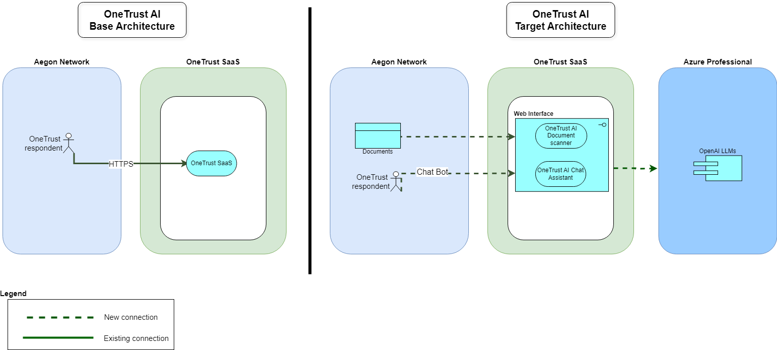
Baseline Technology Architecture
Target Technology Architecture
Describe the changes between the baseline and target architecture

Slide 9
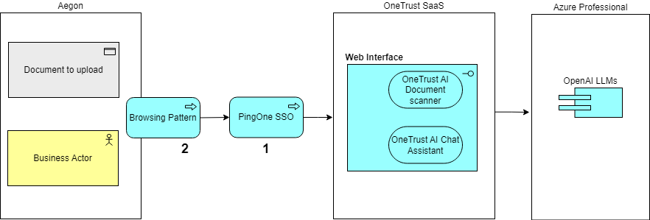
Integration Architecture
# | Components/Patterns used | Purpose
1 | PingOne | Authentication
2 | Browsing Pattern | External HTTPS access

Slide 10
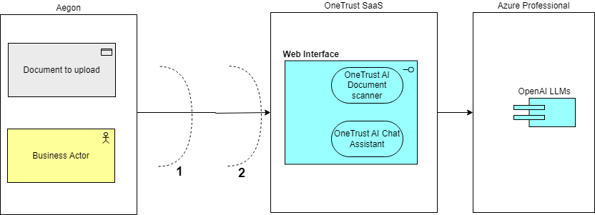
Security Boundaries
Security Boundary Reference |  | Existing Pattern | Description
1 | Firewall | Corporate Firewall
2 | SSO | PingOne Sign on

Slide 11
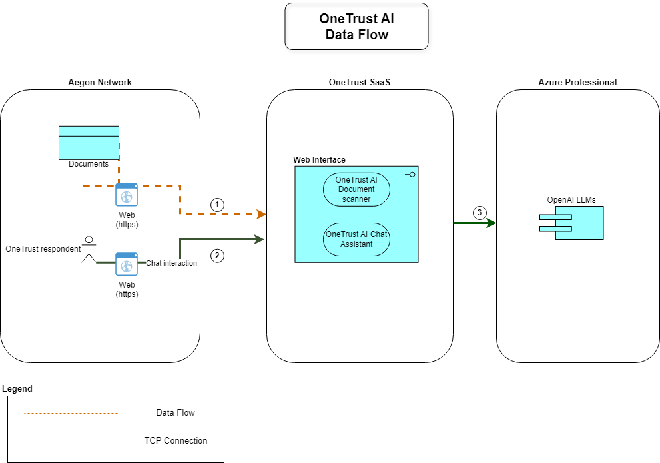
Data Flow
Data Privacy Impact Assessment:
DPIA Number # 12549 GenAI inventory # CC0040 / GTS021
Data Flow Diagram
Data Classification
Data Classification |  | Data Legal and Regulatory Classification
☐ | Strictly Confidential | ☐ | Financial Information
☐ | Confidential | ☐ | Personal Identifiable Information
X | Internal | ☐ | Protected Health Information
☐ | Public | ☐ | Payment Card Information
☐ | No Data Shared | X | No Personal Data Shared
 | Description
1 | The respondent can upload the document to OneTrust using the OneTrust web portal
2 | The respondent can interact with the OneTrust AI chat assistant available in OneTrust web portal.
3 | All LLMs queries are sent to OneTrust’s Azure professional subscription.

Slide 12
Technology Components & Architecture Impacts
Technology Risk Assessment:
[TRA Link or Not Required]
Technology Component Type | Technology Component Name | CMDB ID | Architecture Impact | Tech Lifecycle Strategy | Risk Rating
Business Application | ONETRUST GLOBAL | CI001936362 | Reuse | Buy | Low

Slide 13
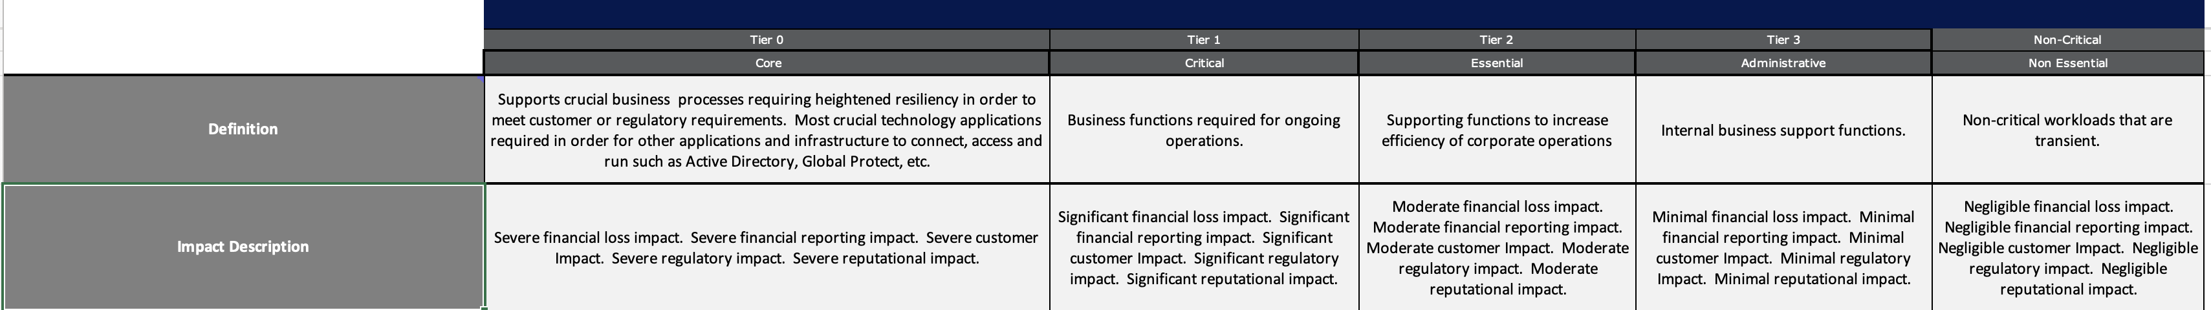
Operational Resiliency Targets
The solution is designed for the following GTS resiliency target level:
OneTrust application should be classified as Tier 2 because it supports compliance and governance functions that are important but not operationally critical to day-to-day business activities.

Slide 14
Waivers and/or Exceptions
Architecture Alignment to Standards Score: <Enter Score>
Risk Acceptances
# | Acceptance Title | Exception Description | Link to Risk Exception Acceptance
1
2
3
4
5
6
7
No Waiver
No Exception
Risk Remediations
# | Remediation Title | Exception Description | Link to Risk Remediation Acceptance
1
2
3
4
5
6
7
Notes Regarding Exceptions to Standards or Additional Concerns
Prior to an item being added to the ARB agenda for Solution Design – Final ARB, approval for risk acceptance or risk remediation must be obtained, not merely logged. Technology owner for the initiative is responsible for obtaining risk acceptance or risk mediation approvals.

Slide 15

Questions?

Slide 16
End of presentation

